Slide 1


COGNITIVE ANALYTICS USING KNOWLEDGE GRAPH TO DELIVER KEY INSIGHTS FOR ESG INVESTMENT DECISIONS
Solving Real World Problems with Analytics
CAPSTONE PROJECT

Slide 2
PROJECT OVERVIEW - AIMEE
PROJECT OVERVIEW
Objective
Analyzing numerical variables (sentiment & relevance scores) & categorical variables
(event, topics, theme, region) to identity the impact of E,S,G events/topics on entities across different industries using Knowledge Graph.

Slide 3
PROJECT OVERVIEW - AIMEE
PROJECT OVERVIEW
Application
Benchmarking selected entities’ ESG activities against its industry/global peers
Recognizing the social context and cultural influence on organizations’ strategies for ESG
Root-cause analysis for specific changes in a target company’s ESG performance

Slide 4
EXPLORATORY
DATA ANALYSIS

Slide 5
Our Dataset
Geographic Data
Document Data
ANALYSIS - SHASHANK
41 Variables
509,580 Rows
276,076
document URLs
2 types
4 Regions
7 Countries
26,953 sources
online
Company Data
Industry and Events
613 entities
Tickers
Subsidiaries
18 sectors
26 events
3 event groups
(E,S,G)

Slide 6
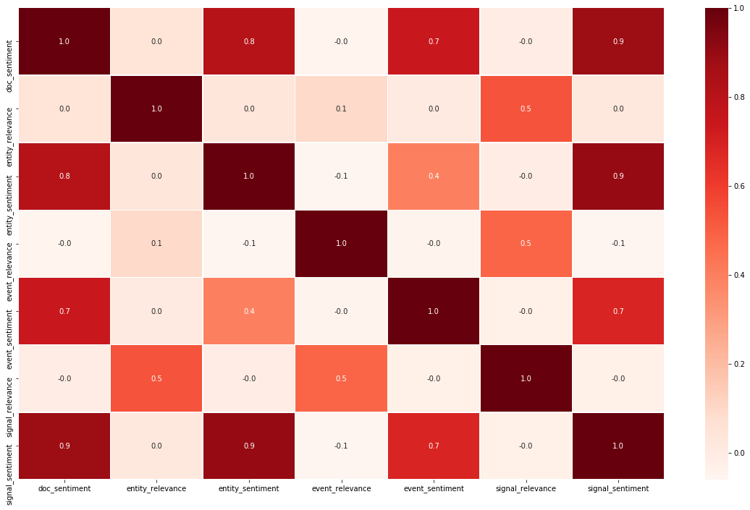
CORRELATION PLOT
AND HEAT MAP
ANALYSIS - SHASHANK

Slide 7
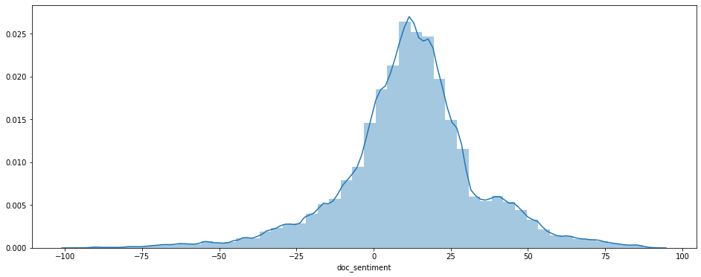
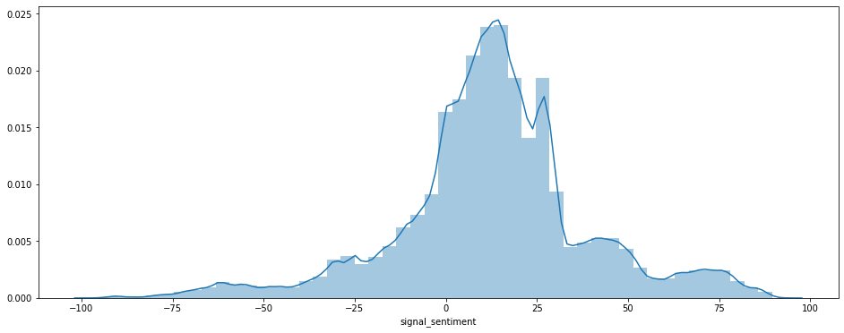
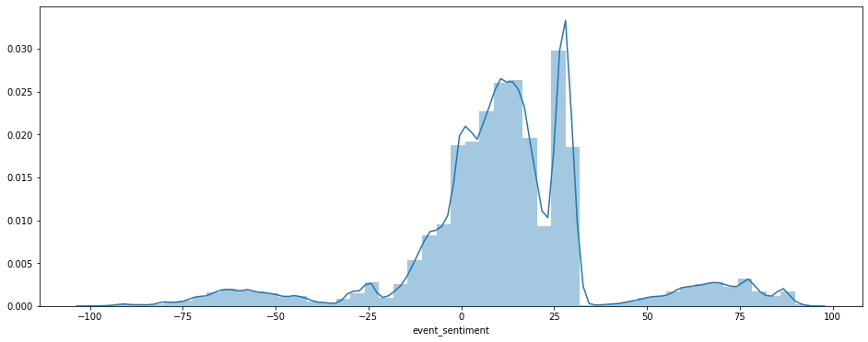
DISTRIBUTION OF
SENTIMENT VALUES
ANALYSIS - SHASHANK
 | Mean | Median
Doc Sentiment | 12.08 | 12.4
Signal Sentiment | 12.83 | 12.96
Event Sentiment | 11.77 | 12.1

Slide 8
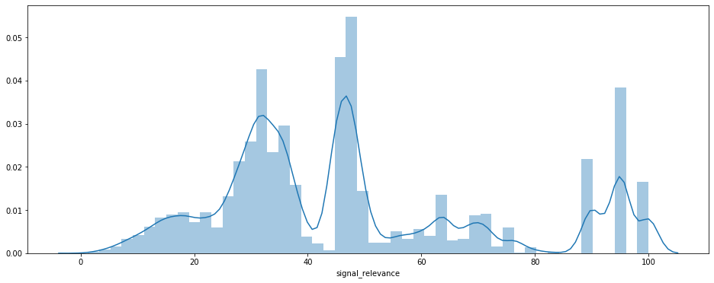
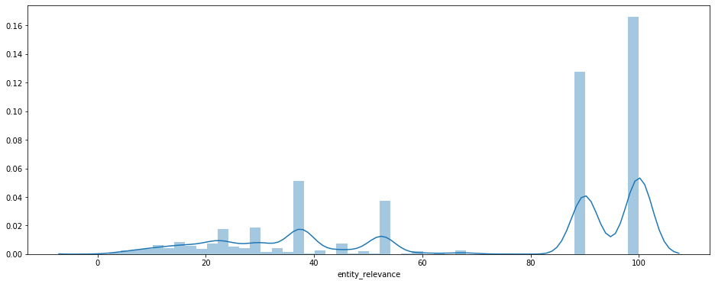
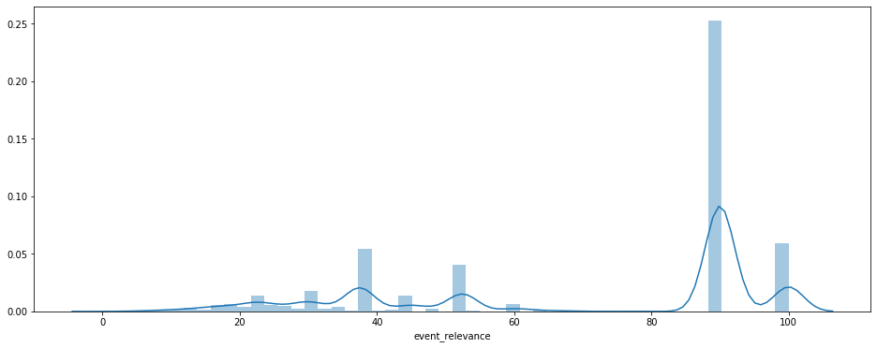
DISTRIBUTION OF
RELEVANCE VALUES
ANALYSIS - SHASHANK
 | Mean | Median
Doc Relevance | 47.64 | 45
Signal Relevance | 69.96 | 90
Event Relevance | 70.64 | 90

Slide 9
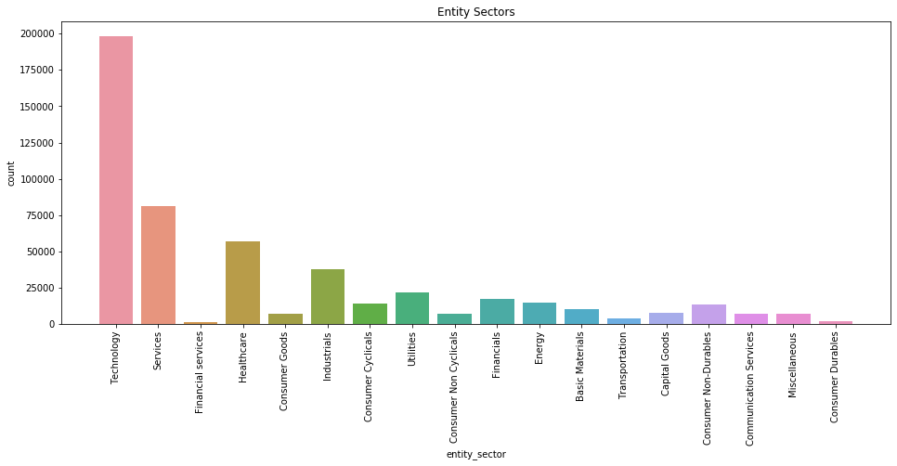
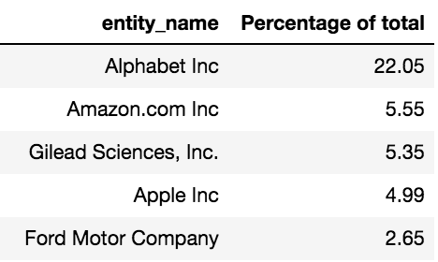
39%
ANALYSIS - SHASHANK
16%
11%
Entity Sectors Counts

Slide 10
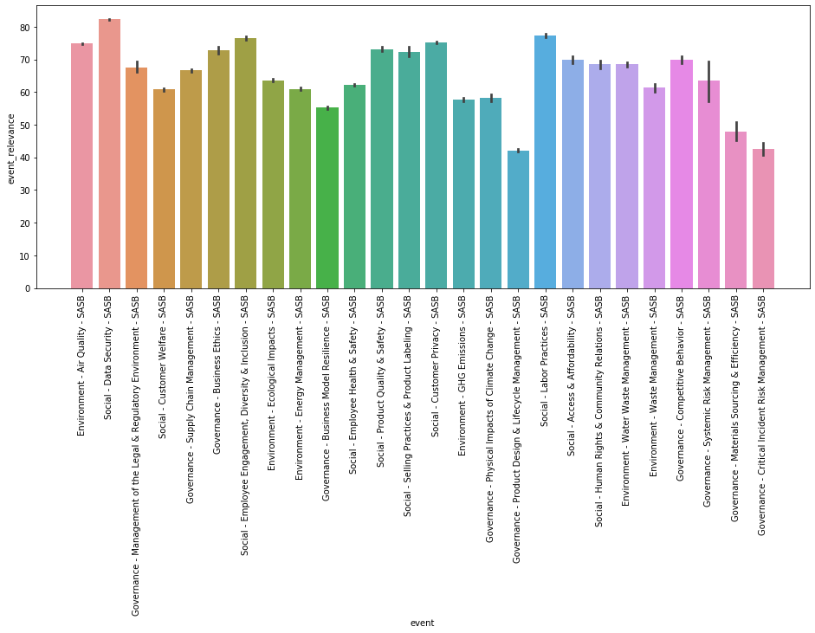
EVENT RELEVANCE
ANALYSIS - SHASHANK

Slide 11
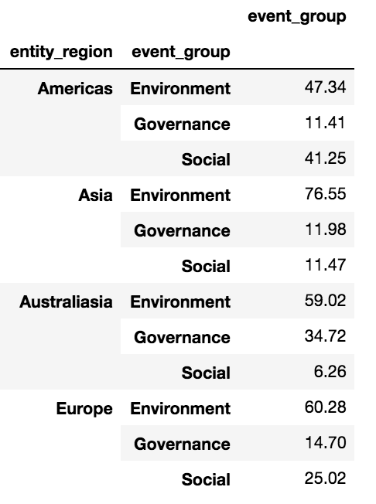
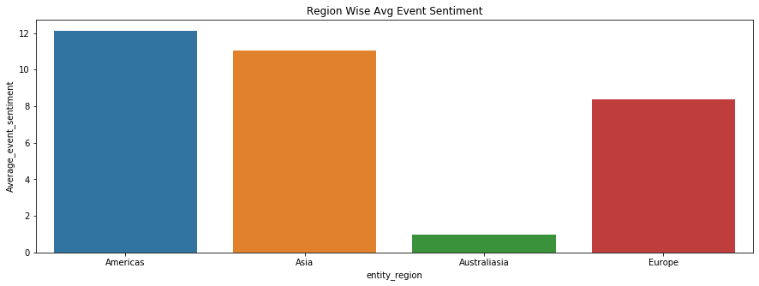
REGION WISE AVERAGE
EVENT SENTIMENT & GROUP
ANALYSIS - SHASHANK

Slide 12
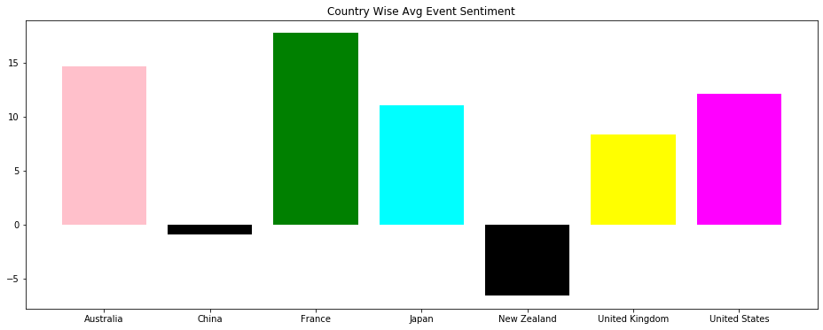
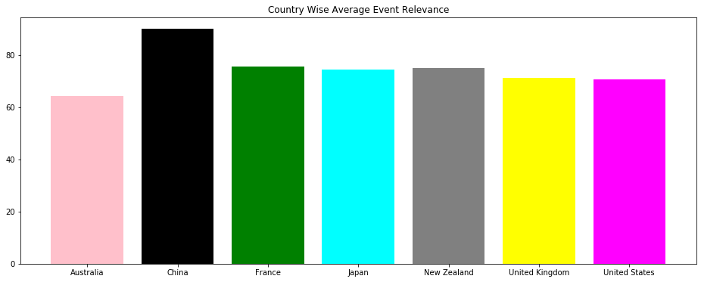
COUNTRY WISE AVERAGE
EVENT SENTIMENT
ANALYSIS - SHASHANK

Slide 13
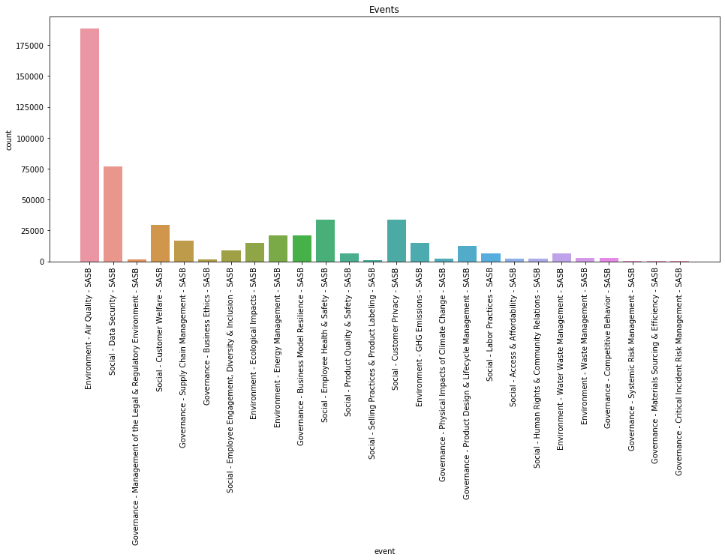
Air Quality 37%
ANOMALY ANALYSIS - LOAN
Data Security 17%
Customer Privacy 7%

Slide 14
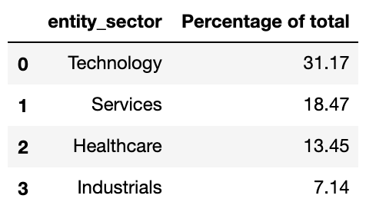
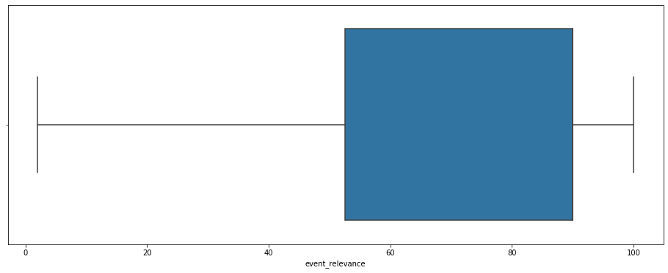
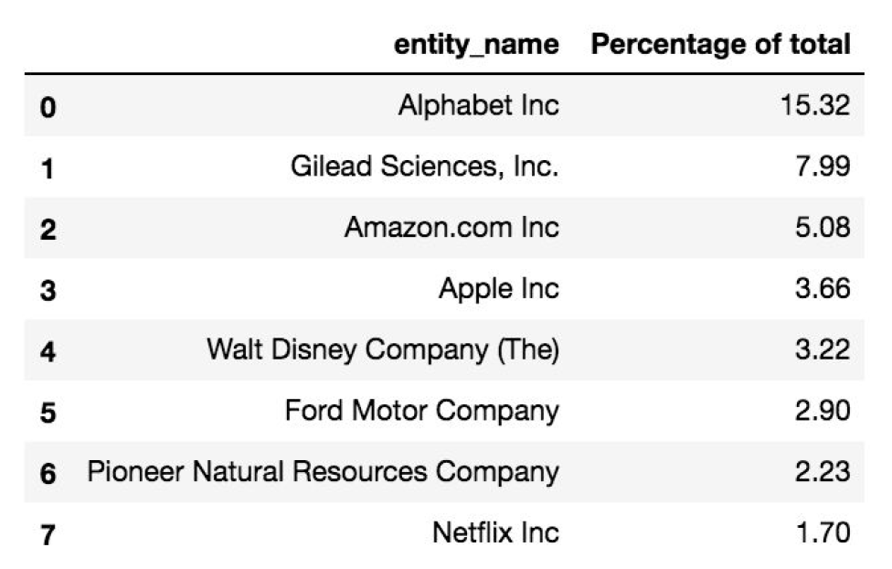
ENVIRONMENT AIR QUALITY SASB DISCREPANCY
ANOMALY ANALYSIS - LOAN
 | MEAN | MEDIAN
EVENT RELEVANCE | 74.81 | 90

Slide 15
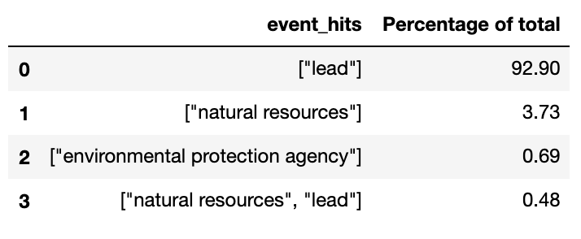
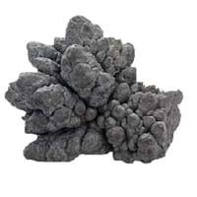

ENVIRONMENT AIR QUALITY SASB DISCREPANCY
Accern’s NLP algorithm was interpreting...
ANOMALY ANALYSIS - LOAN
Metal “Lead”
instead of..
Removing the incorrect interpretation would leave us with only 2.63% of events representing air quality in the dataset.
Ultimately, leaving us with 321K observations from 510K initially.
To move forward & accurately model the data, we are requesting more data.
Verb “Lead”

